Slide 1
Dynamic Operating Envelopes
Athul Jose P
11867566

Slide 2
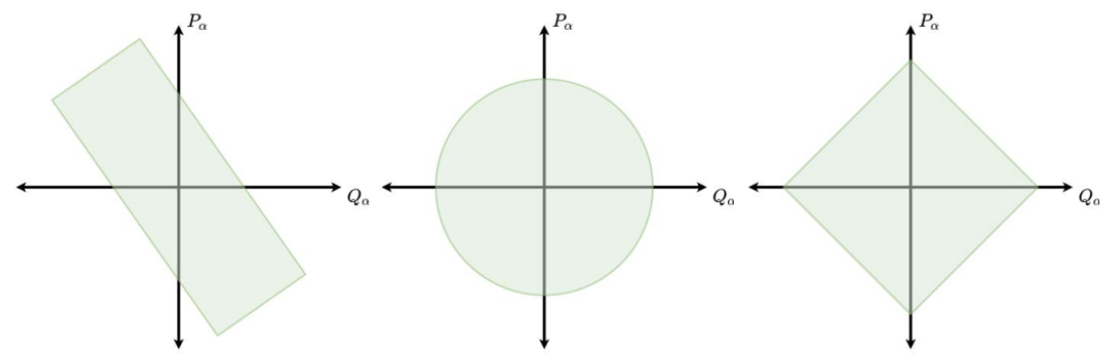
Introduction
Increased renewable installation at distribution level
Opportunity to participating in markets
To prevent network violations – curtail generation
Unutilized installed capacity of DERs
Operating Envelopes
Dynamic Operating Envelopes
DEIP, “Dynamic operting envelopes working group outcomes report,” DEIP, Tech. Rep., 2022.

Slide 3
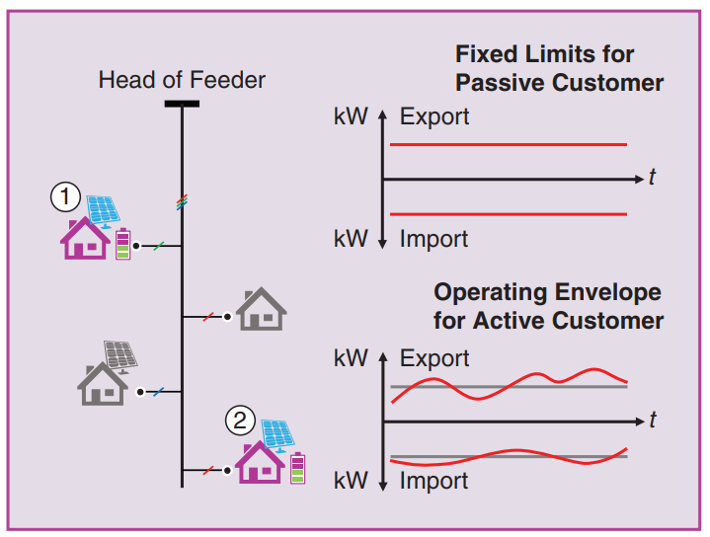
Dynamic Operating Envelope (DOE)
Operating envelopes are the limits that an electricity customer can import and export to the electricity grid
Dynamic Operating Envelopes (DOEs) are where import and export limits can vary over time and location.
DOEs could be used to manage ’flexible loads’ such as water heaters, battery storage and electric vehicles (EVs)
Benefits
1. More solar / battery support 2. Market Efficiency 3. Greater Interoperability 4. Network Efficiency
DEIP, “Dynamic operting envelopes working group outcomes report,” DEIP, Tech. Rep., 2022.

Slide 4
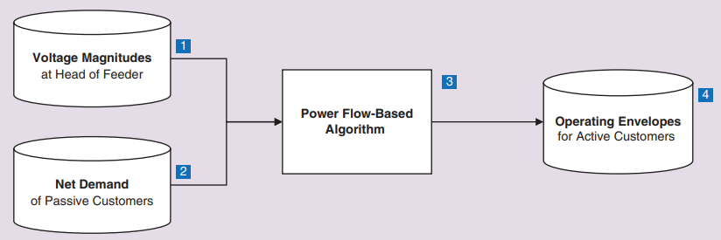
Calculating DOE
Runs series of power flow to explore different combinations of export/imports
OEs are generated for each time period (15 min) in the horizon of interest (6 h)
Different forecasting methods or advanced metering can be added to improve performance of OEs
M. Z. Liu, L. N. Ochoa, S. Riaz, P. Mancarella, T. Ting, J. San, and J. Theunissen, “Grid and market services from the edge: Using operating envelopes to unlock network-aware bottom-up flexibility,” IEEE Power and Energy Magazine, vol. 19, no. 4, pp. 52–62, 2021.

Slide 5
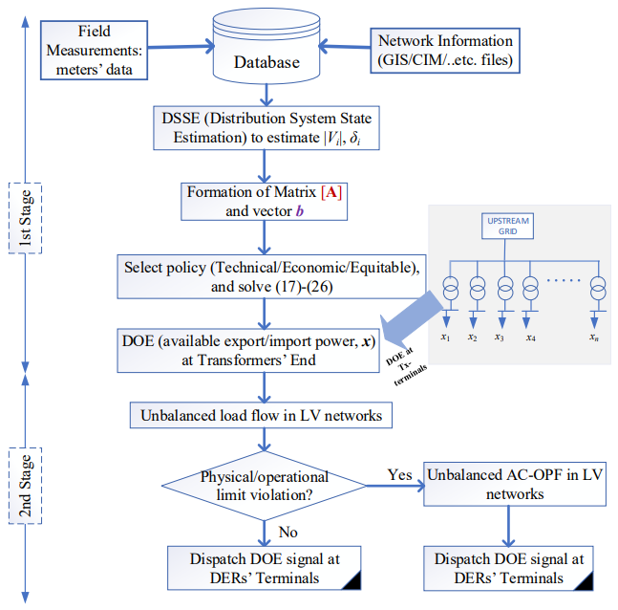
Allocation of DOE
Two stage approach to allocate DOE
Distribution System State Estimation (DSSE)
Capacity Constrained State Optimization (CCSO)
Top-down approach and DOEs calculated at MV-LV transformer points
Optimal distribution of allocated DOEs among DOE-enabled customers ensuring reasonable fairness
DOEs generated at 5/10 min interval
M. Alam, P. T. Nguyen, L. Naranpanawe, T. K. Saha, and G. Lankeshwara, “Allocation of dynamic operating envelopes in distribution networks: Technical and equitable perspectives,” IEEE Transactions on Sustainable Energy, 2023.

Slide 6
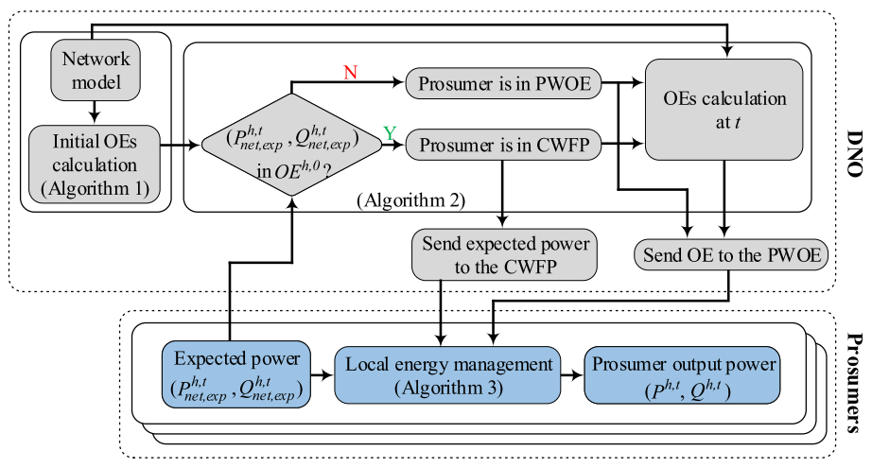
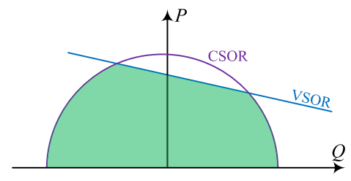
DOE Control Framework
DNOs control customers through allocated DOEs
Prosumers can independently manage their assets without direct involvement of third party
Y. Z. Gerdroodbari, M. Khorasany, and R. Razzaghi, “Dynamic pq operating envelopes for prosumers in distribution networks,” Applied Energy, vol. 325, p. 119757, 2022.

Slide 7
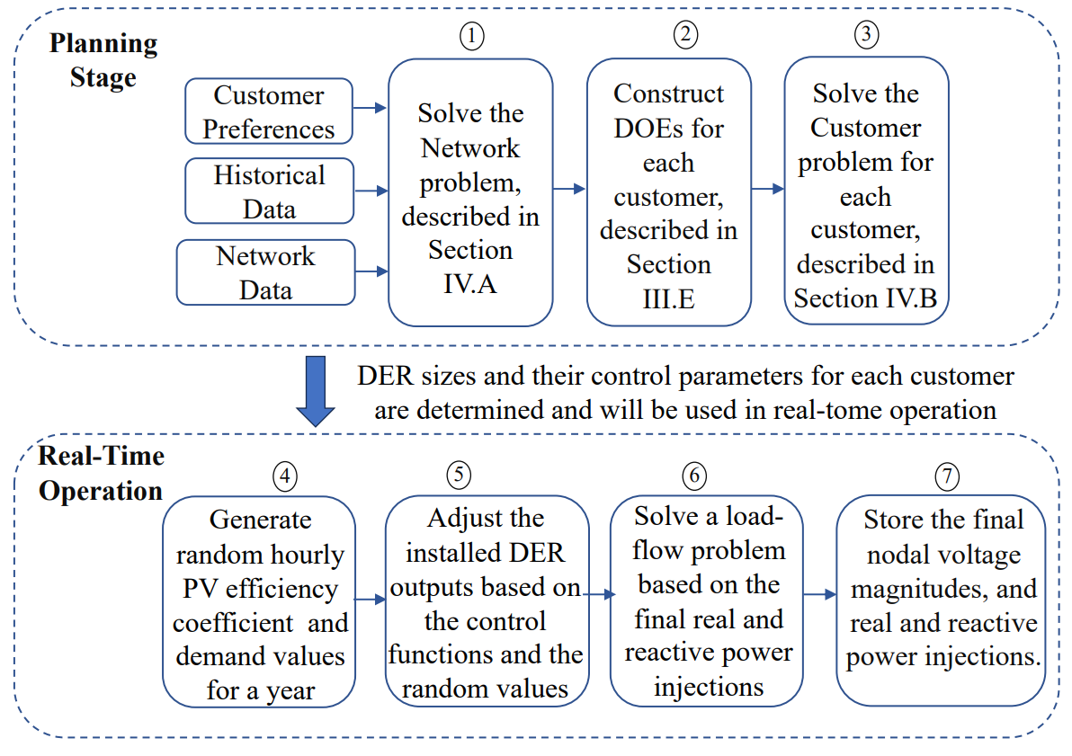
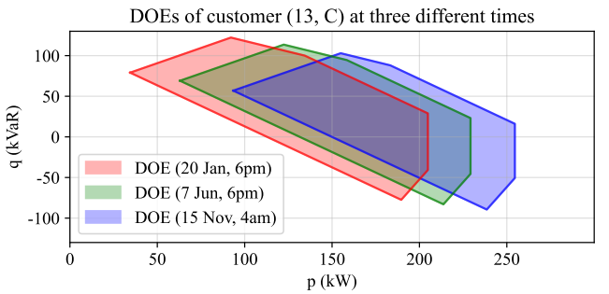
DOE with Decomposition Method
DOEs is defined by non empty convex set
Right Hand Side Decomposition Method is superior in allocation of joint resource shares and independent sectors
As the no of DOEs increases, method produce less wider DOEs
M. Mahmoodi, L. Blackhall, S. M. N. RA, A. Attarha, B. Weise, and A. Bhardwaj, “Der capacity assessment of active distribution systems using dynamic operating envelopes,” IEEE Transactions on Smart Grid, 2023

Slide 8
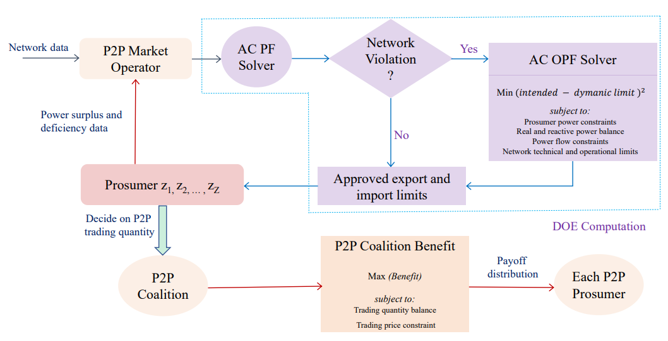
DOE based Market for Prosumers
Network aware P2P trading is developed utilizing cooperative game theory
Different power export capabilities
Self sufficient
Clean energy
Profit
M. I. Azim, G. Lankeshwara, W. Tushar, R. Sharma, M. R. Alam, T. K. Saha, M. Khorasany, and R. Razzaghi, “Dynamic operating envelope-enabled p2p trading to maximise financial returns of prosumers,” IEEE Transactions on Smart Grid, 2023

Slide 9
Comparison and Relation to EE 521
Use of power flow, state estimation and optimal power flow to calculate DOEs
Paper | Content
1 | Introduction to DOE and calculation
2 | Complete steps to calculate DOE
3 | DOE based control framework
4 | DOE with decomposition method
5 | DOE based market for prosumers

Slide 10


Summary
DOEs are used for greater network efficiency and more market operation of DERs
Main component of DOE is checking the network violations from power flow
DOEs can be used with prosumers for electricity markets and shown to be efficient

Slide 11



